Slide 1

Virtual Sensor Capability Demonstration on MAF Sensor: An Imagineering Project
Nirav Sodha
Kaustubh Gaonkar
Saurabh Kumar Gupta

Slide 2
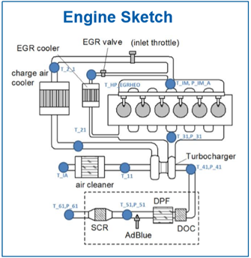
Schematics of The Model
Input Signals:
Ambient Temperature (T_IA)
Ambient Pressure (P_IA)
Manifold Temperature (T_IM)
Manifold Pressure (P_IM)
EGR valve opening (%)
Engine Speed (N)
Engine Torque (T)
Output/ Predicted Signal:
1. Mass Airflow (HFM)

Slide 3
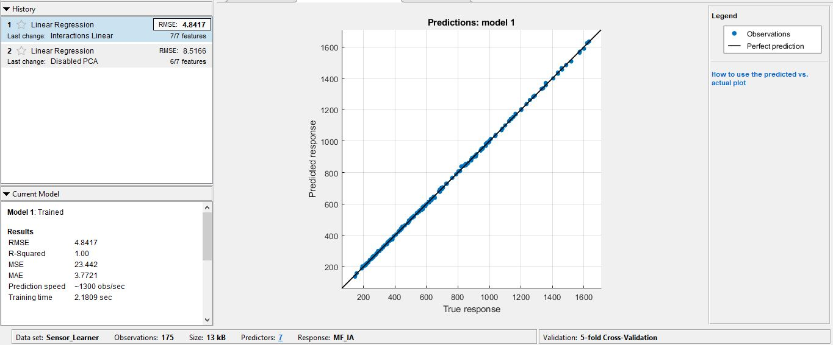
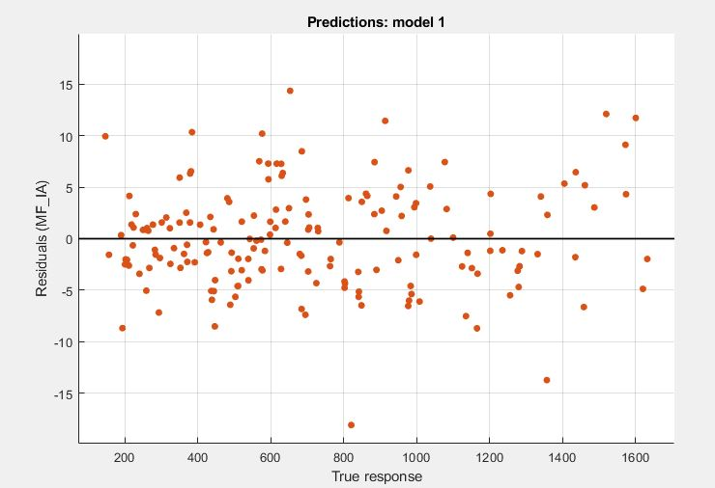
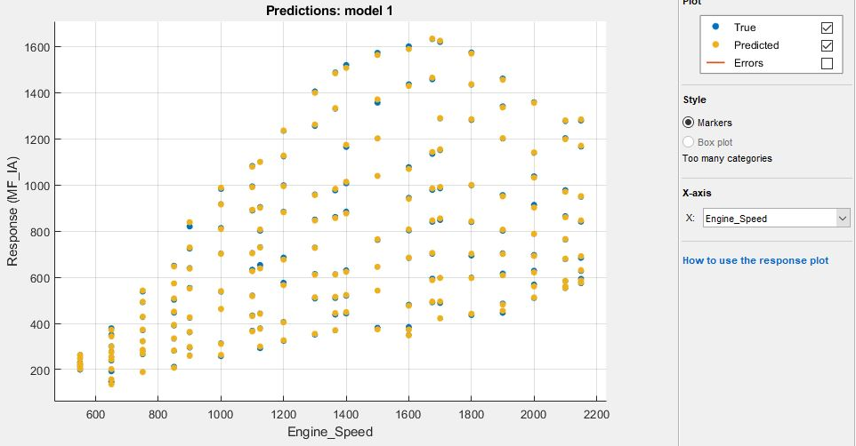
Results of 12L AVL Cruise Reference Engine – Training Accuracy
Prediction is very accurate across loads and speeds

Slide 4
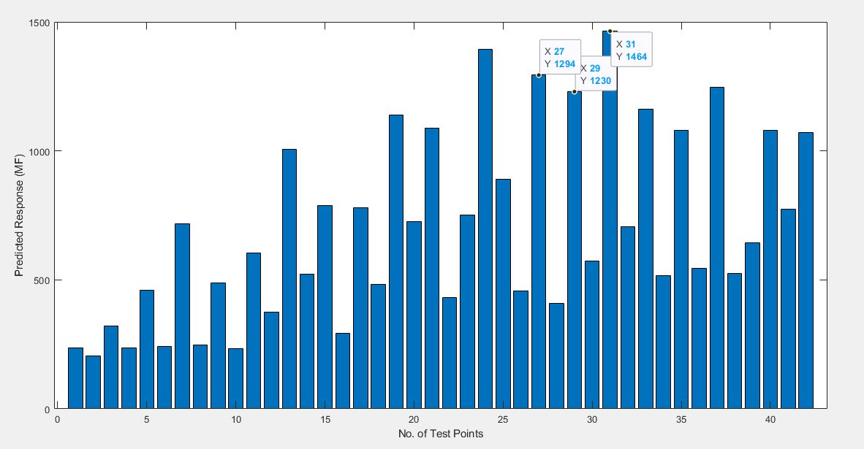
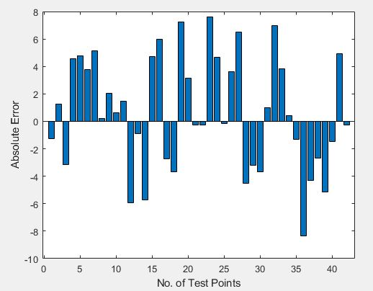
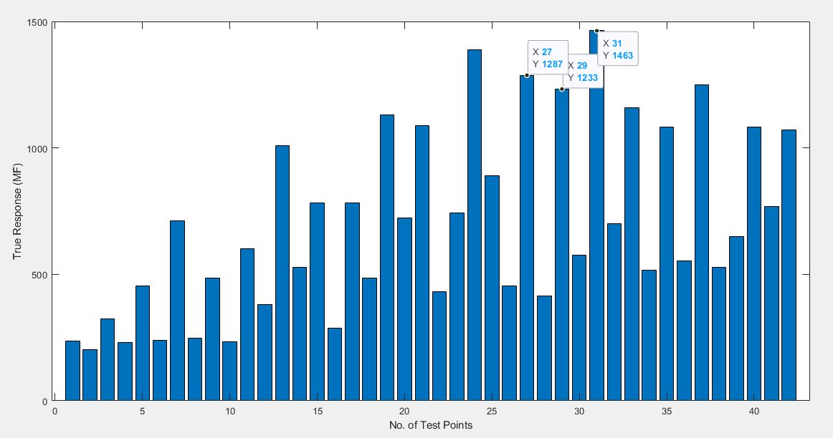
Results of 12L AVL Cruise Reference Engine – Model Prediction Accuracy
Absolute Error:
MSE of predicted values: 16.8620
RMSE of predicted values: 4.1063
Maximum Percentage Error: 2.1%

